Slide 1
Neural Network
Instructor: Dr. Yan Yan

Slide 2
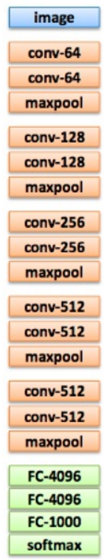
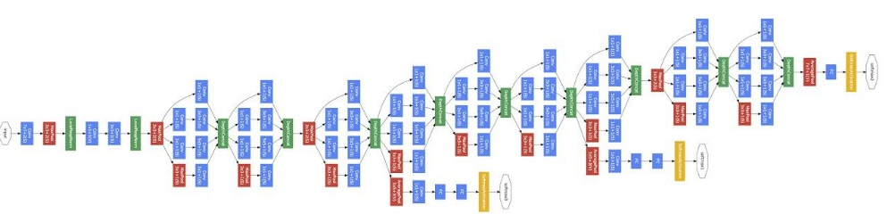
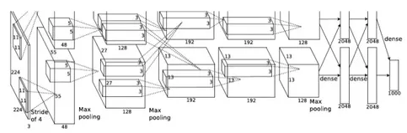
Deep = Many hidden layers
22 layers
19 layers
8 layers
6.7%
7.3%
16.4%
AlexNet (2012)
VGG (2014)
GoogleNet (2014)

Slide 3
Deep = Many hidden layers
152 layers
Special
structure
Ref: https://www.youtube.com/watch?v=dxB6299gpvI
3.57%
7.3%
6.7%
16.4%
AlexNet (2012)
VGG (2014)
GoogleNet (2014)
Residual Net (2015)

Slide 4








Matrix Operation
1
4
0.98
1
-2
1
-1
-2
0.12
-1
1
0
$$\left[\begin{matrix}1 & −2 \\ −1 & 1\end{matrix}\right]$$
$$\left[\begin{matrix}1 \\ −1\end{matrix}\right]$$
$$\left[\begin{matrix}1 \\ 0\end{matrix}\right]$$
$$=$$
$$\left[\begin{matrix}0.98 \\ 0.12\end{matrix}\right]$$
$$σ\left( \right)$$
$$+$$
$$\left[\begin{matrix}4 \\ −2\end{matrix}\right]$$

Slide 5


Neural Network
……
y₁
W¹
W²
W^{L}
……
y₂
b¹
b²
b^{L}
…
…
…
…
…
x
a¹
a²
y
…
y_{M}
W¹
x
b¹
+
$$σ\left( \right)$$
a¹
b²
W²
+
$$σ\left( \right)$$
W^{L}
b^{L}
a^{L-1}
+
$$σ\left( \right)$$

Slide 6

Neural Network
……
y₁
W¹
W²
W^{L}
……
y₂
b¹
b²
b^{L}
…
…
…
…
…
x
a¹
a²
y
…
y_{M}
y
x
Using parallel computing techniques to speed up matrix operation
$$=f\left( \right)$$
W^{L}
…
W²
W¹
x
b¹
b²
…
b^{L}
+
+
+
$$σ\left( \right)$$
$$=σ\left( \right)$$
$$σ\left( \right)$$

Slide 7
Output Layer as Multi-Class Classifier
Feature extractor replacing feature engineering
…
y₁
…
y₂
Softmax
…
…
……
…
…
…
y_{M}
Input Layer
Output Layer
= Multi-class Classifier
Hidden Layers

Slide 8
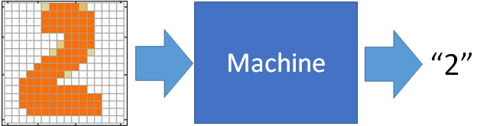
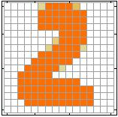
Example Application
Output
Input
Each dimension represents the confidence of a digit.
y₁
is 1
0.1
y₂
is 2
The image is “2”
0.7
…
…
…
y₁₀
0.2
is 0
16 x 16 = 256
Ink → 1
No ink → 0

Slide 9
Example Application
Handwriting Digit Recognition
y₁
is 1
Machine
y₂
is 2
Neural
Network
“2”
…
…
…
y₁₀
is 0
What is needed is a function ……
Input:
256-dim vector
Output:
10-dim vector

Slide 10
Example Application
Input
Layer 1
Layer 2
Layer L
Output
……
y₁
is 1
……
A function set containing the candidates for
Handwriting Digit Recognition
y₂
is 2
“2”
……
……
……
…
…
…
……
y₁₀
is 0
Input Layer
Output Layer
Hidden Layers
You need to decide the network structure to let a good function in your function set.

Slide 11
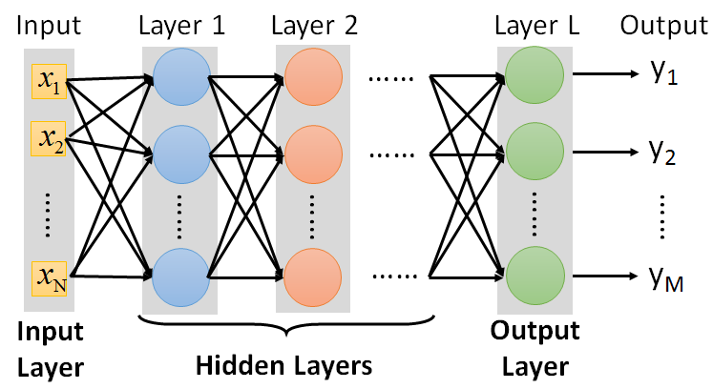
FAQ
FAQ
Q: How many layers? How many neurons for each layer?
Q: Can the structure be automatically determined?
E.g. Evolutionary Artificial Neural Networks
Q: Can we design the network structure?
Trial and Error
+
Intuition
Convolutional Neural Network (CNN)

